Slide 1
Design & Analysis
of Algorithms
Lecture # 3
AHSAN HUMAYUN
ahsanhumayun.ah@gmail.com

Slide 2
In the Last Lecture
Selection Problem

Slide 3
Today’s We Will Cover..
Growth of the Function
Asymptotic Notations

Slide 4
Growth of Functions

Slide 5
Growth of functions
At what rate the functions will grow if we increase the input size approximately towards infinite

Slide 6
Growth of Functions
Input Size | Time of T(n)
50 | 0.01265
100 | 0.0503
500 | 1.2515
1000 | 5.003
5000 | 125.015
10000 | 500.03
100000 | 50000.3
1000000 | 5000003

Slide 7
Complexity of the algorithms
Algorithm complexity is the work done by the algorithm there are following complexities:
Worst case time
Average case time
Best case time
Expected time

Slide 8
Best, Worst and Average Cases
Best case = fastest time to complete, with optimal inputs chosen. For example, the best case for a sorting algorithm would be data that's already sorted
Worst case = slowest time to complete, with passim inputs chosen. For example, the worst case for a sorting algorithm might be data that's sorted in reverse order (but it depends on the particular algorithm).
Average case = arithmetic mean. Run the algorithm many times, using many different inputs of size n that come from some distribution that generates these inputs (in the simplest case, all the possible inputs are equally likely), compute the total running time (by adding the individual times), and divide by the number of trials.

Slide 9
Important
We will almost always work with worst case time.
Average case time is most difficult to compute
Worst case refer to the upper limit on the running time

Slide 10
Asymptotic Notations
Growth of the functions is represented using asymptotic notations
There are five asymptotic notations:
Θ–notation (Big Theta)
Ο-notation (Big Oh)
Ω -notation (Big Omega)
o –notation (Small Oh)
ω- notation (Small Omega)

Slide 11
Big theta Θ
Given a function g(n), we define Θ(g(n)) to be a set of functions that are asymptotically equivalent to g(n)
For example functions:
4n²
8n²+2n-3
n²/5+10log n
All are asymptotically equivalent Θ(n²)

Slide 12
Formal definition
Θ(g(n))={ f(n): there exist positive constants c1, c2 and n0 such that
0 ≤ c1g(n) ≤ f(n) ≤ c2g(n)
for all n ≥ n0
}

Slide 13
Asymptotic Notation
This is written as “f(n) = Θ(g(n)) “ or
“f(n) ε Θ(g(n)) “
That is f(n) and g(n) are asymptotically equivalent
This means that they have essentially same growth rate

Slide 14
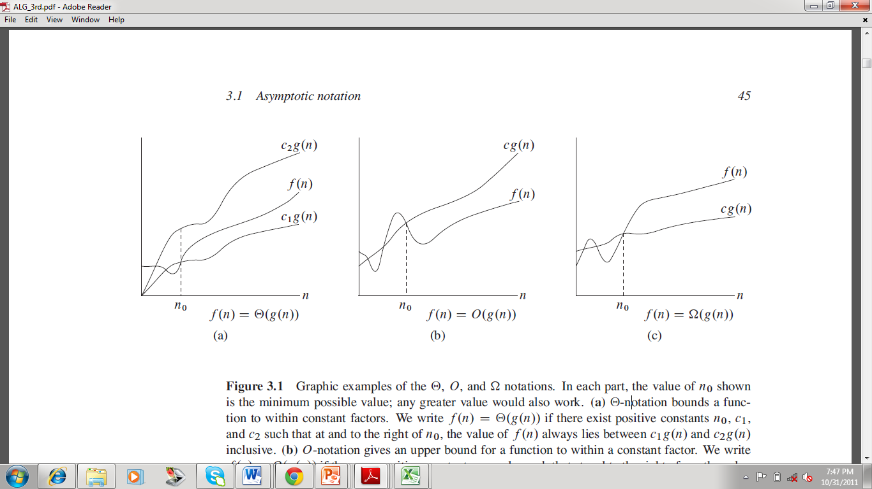

Slide 15
Example
Lower Bound
f(n)= 8n² + 2n – 3 grows asymptotically at least as fast as n²
Upper Bound
f(n) grows faster asymptotically than n²

Slide 16
Ο-notation and Ω-notation
The definition of Θ–notation relies on proving both lower and upper asymptotic bounds
Sometime we only interested in proving one bound or the other
Ο-notation used to define the upper bound
Ω -notation used to define the lower bound

Slide 17
Ο-notation(Big-oh)
Ο(g(n))={f(n): there exist positive constants c and n0 such that
0 ≤ f(n) ≤ cg(n)
for all n ≥ n0
}

Slide 18
Ω-notation(Big-omega)
Ω(g(n))={f(n): there exist positive constants c and n0 such that
0 ≤ cg(n) ≤ f(n)
for all n ≥ n0
}

Slide 19
Asymptotic notations
Θ(g(n)) : 0 ≤ c1g(n) ≤ f(n) ≤ c2g(n)
Ω(g(n)) : 0 ≤ cg(n) ≤ f(n)
Ο(g(n)) : 0 ≤ f(n) ≤ cg(n)

Slide 21
Famous Asymptotic orders
Θ(1) constant time
Θ(lg n)
Θ(n)
Θ(nlg n) best sorting algorithms
Θ(n²) and Θ(n³) good only in small values
Θ(2^{n}) Exponential time
Θ(n!), Θ(n^{n}) only acceptable n<=20

Slide 22
Θ(1) Algorithms
void function(int size, int a[ ]){
int x=a[0];
a[0]=a[size-1];
a[size-1]=x;
}
Θ(1)

Slide 23
Algorithms
int small(int x,int y){
int s;
(x<y ? s=x: s=y);
return s;
}
Θ(1)

Slide 24
Algorithms
void minimum(int size, int a[]){
int min;
min=a[0];
for(int i=1;i<size;i++){
if(a[i]<min)
min=a[i];
}
cout<<"\nMinimum Element :"<<min;
}
=2n+3
Θ(n)

Slide 25
Asymptotic Notations
For any two functions f(n) and g(n) we have f(n)= Θ(g(n)) if and only if f(n) = Ο(g(n)) and f(n)= Ω(g(n))
Asymptotic notations can be used in equations and inequalities i.e.
x⁴ + 2x² + 5x +33
=x⁴ + Θ(x²)

Slide 26
ο-Notation
Ο-notation may or may not be tight bound
The bound 2n²=Ο(n²) is asymptotically tight
The bound 2n=Ο(n²) is not asymptotically tight
We use о-notation to show upper bound that is not asymptotically tight bound so 2n= о(n²) but 2n²≠ o(n²)

Slide 27
ω-Notation
Ω-notation may or may not tight bound
We denote ω-notation to show lower bound that is not asymptotically tight bound f(n) = n²/2
n²/2=ω(n)
n²/2≠ω(n²)

Slide 28
Asymptotic Notations
f(x)=17x+11
g(x)=x² + 1000
h(x)=x⁴ + 2x
Check whether these are:
Θ(x²)
Ο(x²), Ο(x⁴)
Ω(x²), Ω(x⁴)

Slide 29
Asymptotic Notations
O(n³),o(n³), Θ(n²), Ω(n²),w(n) for following functions
f(n)=nlgn+n²+n³
g(n)=12n²+50

Slide 30
How functions grow
Algorithm | 1 | 2 | 3 | 4 | 5
 | 33n | 46nlgn | 13n² | 3.4n³ | 2^{n}
Input(n) |  | Solution time
10 | .0003s | .0015s | .0013 | .0043 | .001s
100 | .003s | .03s | .13s | 3.4s | 4.10¹⁶y
1000 | .033s | .45s | 13s | .94h
10000 | .33s | 6.1s | 22m | 39d
100000 | 3.3s | 1.3m | 1.5d | 108y

